Slide 1


Coffee Sales Analysis using Excel
Start Your Day With Coffee

Slide 2


Objective
The main objective of this project is to analyze retail sales data to gain actionable insights that will enhance the performance of the Coffee Shop.

Slide 3

Analysis
How do sales vary by day of the week and hour of the day?
Are there any peak times for sales activity?
What is the total sales revenue for each month?
How do sales vary across different store locations?
what is the average price/order per person ?
How do sales vary by product category and type?

Slide 4
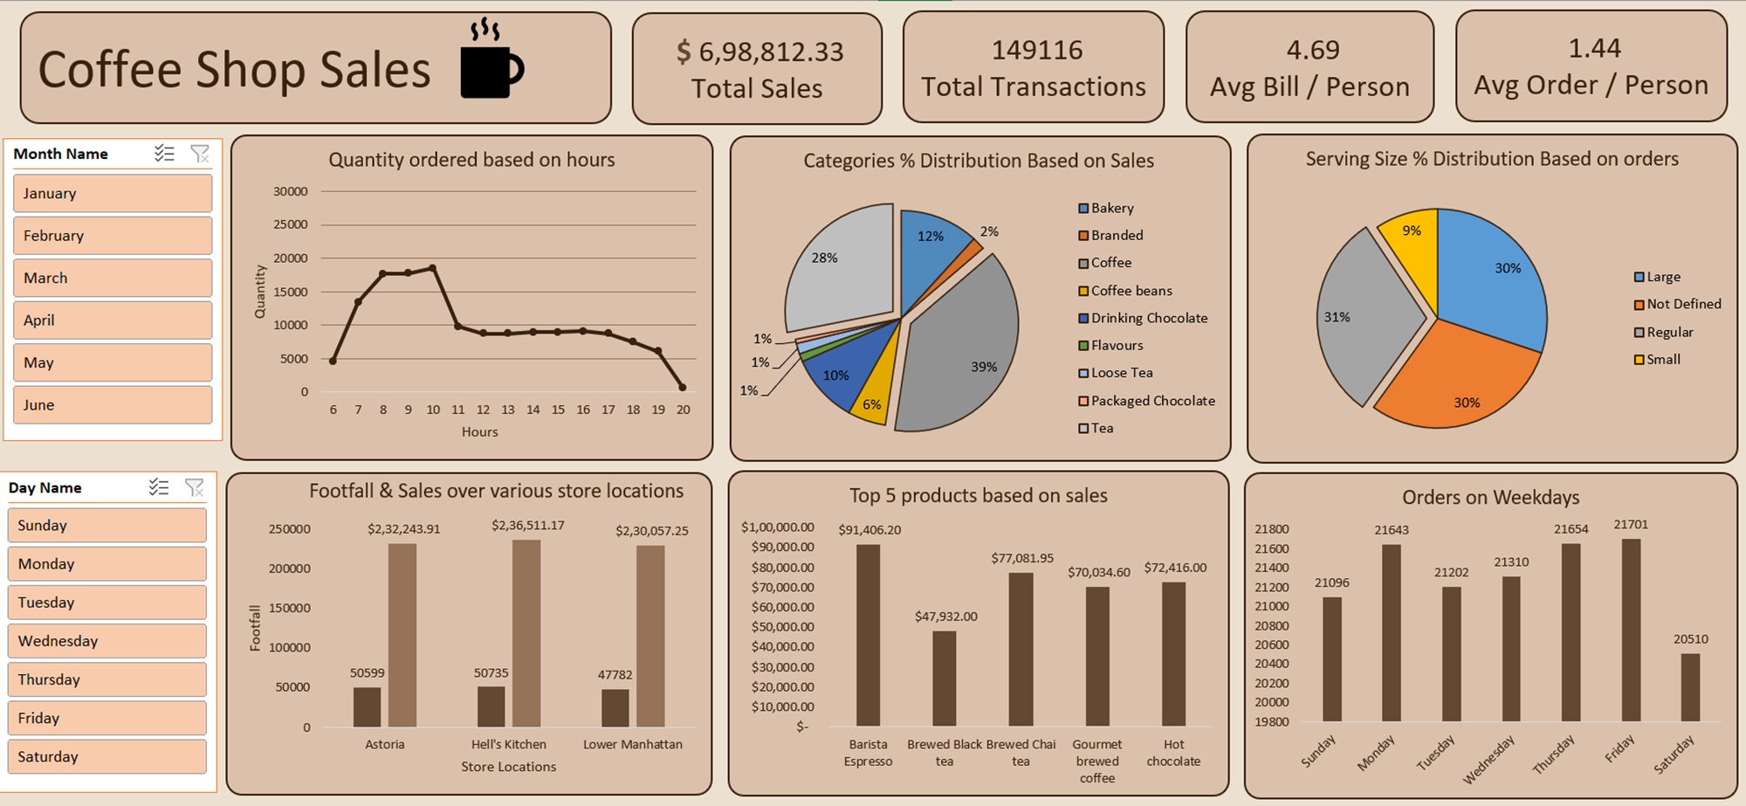
Dashboard

Slide 5



Contact
+91 9960- 301- 557
https://ankandas01.github.io/
21ankandas@gmail.com

